Slide 1
Dengue vs Rainfall Analysis
JIN JIN
DSI 37

Slide 2
Context
I am …
A Junior Analyst
You are from …
NEA
This is …
an exploratory session on the relationship between rainfall on dengue cases

Slide 3
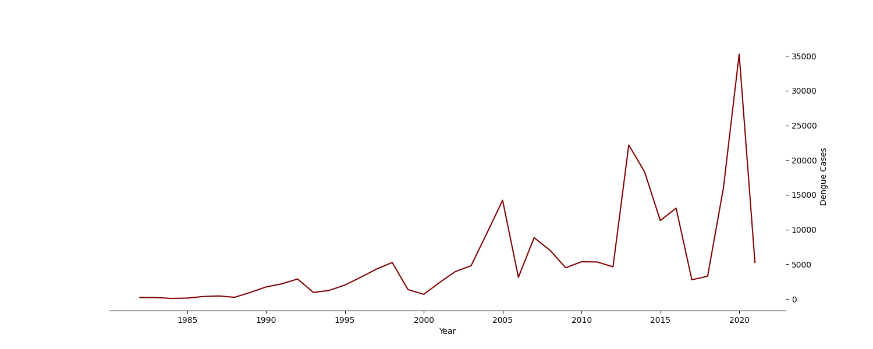
Top endemic infectious disease 4x Death Toll from 2021 to 2022 (19 cases) Rainfall patterns as a driver
Notes:
Top endemic disease
https://www.nmrc.gov.sg/docs/default-source/about-us-library/idtf-summary-report.p
4x death toll
https://www.straitstimes.com/singapore/health/singapore-records-19-dengue-deaths-in-2022-nearly-four-times-2021-s-toll
Rainfall patterns are one of the main drivers of dengue transmission as mosquitoes require standing water to reproduce. However, excess rainfall can be disruptive to the Aedes reproductive cycle by “flushing out” aquatic stages from breeding sites.
https://journals.plos.org/plosntds/article?id=10.1371/journal.pntd.0006935

Slide 4
Problem Statement
Improving resource allocation and preventive measures by exploring rainfall-dengue trends to reduce public resource overload.

Slide 5
Method
Datasets
Number of Rainy Days
Dengue Cases
Yearly (1966 -2021) | Weekly (2014-2018)
Analysis
Monthly Trend
Correlation | Lagged
Yearly Trend
Anomalies

Slide 6
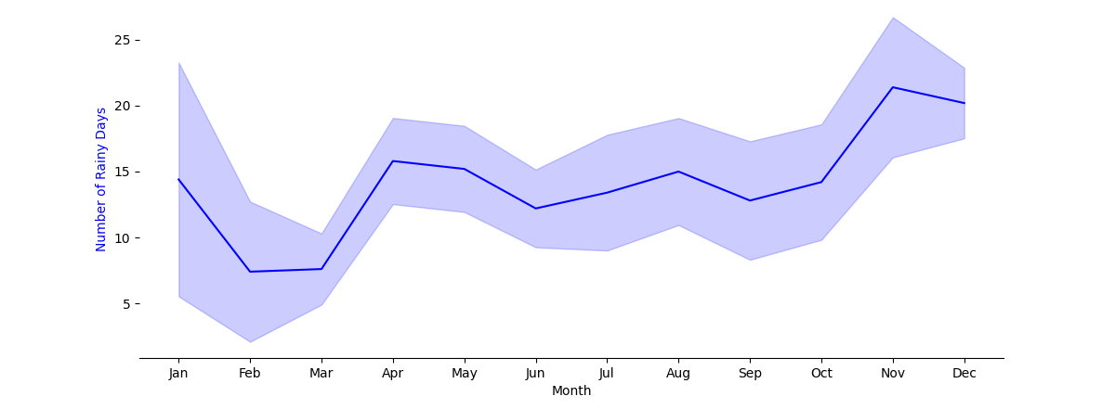
MONTHLY TREND (2014-2018) Number of rainy days depends on monsoon cycles
NE Monsoon season
Dry phase
NE Monsoon season
Wet phase
SW Monsoon season
Inter-Monsoon season
Inter-Monsoon season
Max
Min
Notes:
NE Monsson season: Dec – Jan : wet season. Feb-March: dry phase
http://www.weather.gov.sg/climate-climate-of-singapore/

Slide 7
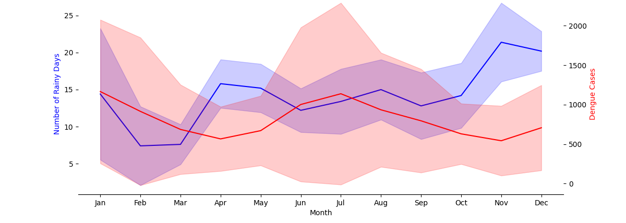
MONTHLY TREND (2014-2018) Cyclic trend of dengue cases seemed to “lag behind”
Wide error bar
Max
Min
Min
Notes:
Great variation across the years, which we will see later.
Coeff: -0.26 → negative

Slide 8
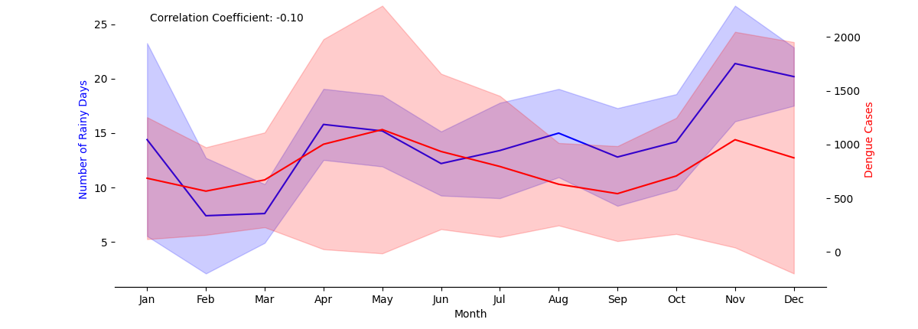
MONTHLY TREND (2014-2018) Lagged Analysis: Optimal ‘match’ at 2 months lagged period
Shifted dengue data forward by 2 months - Mosquitoes take time to breed and transmit diseases
Max
Min

Slide 9
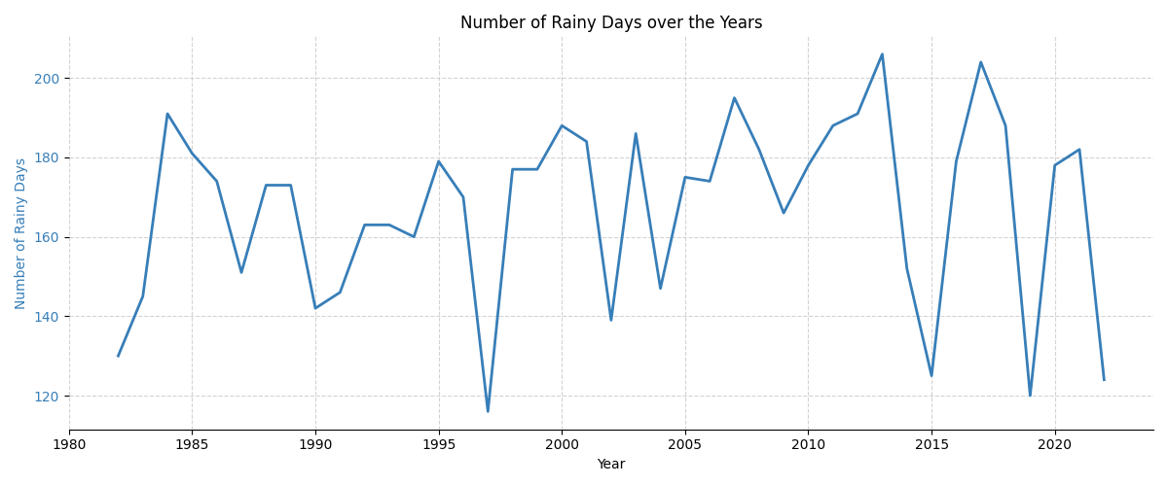
YEARLY TREND (1982-2022 ) Rather irregular fluctuations
Extremities attributed to La Nina and El Nino effects
Greater fluctuations in recent years
La Nina: brings more rain over equatorial SEA
2007
2007
1997
El Nino: brings about drier climate
Notes:
The La Nina climate phenomenon, which brings more rain over equatorial South-east Asia, had been in effect for 2021 and 2007. 2021 was Singapore's second-wettest year on record due to La Nina climate phenomenon.
Troughs like the one in 1997 was attributed to the El Nino weather phenomenon. El Nino a pile-up of warm water in the eastern Pacific Ocean can alter the direction of cooling and moisture-bearing winds in Asia. The phenomenon occurs every two to seven years, and usually lasts for about 18 months. (Reference: https://www.tehrantimes.com/news/5228/1997-Singapore-s-Hottest-Driest-Year)

Slide 10
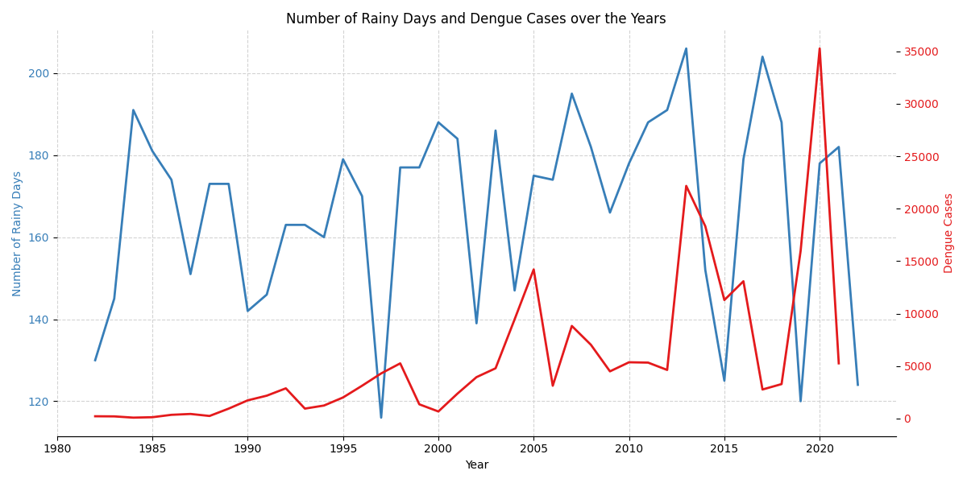
YEARLY TREND (1982-2022 ) Most dengue peaks are associated with peaks in total rainfall
2021: Covid-19 surge in cases, affecting detection and reporting of dengue cases
Inconsistent observation in recent years
Notes:
Most dengue peaks are associated with peaks in total rainfall, but you don’t get the same observations in recent years, so greater need for temperature, and humidity as a reference.
The higher temperatures observed in 2019 and 2020:
Dengue transmission in or near homes is another critical factor for dengue outbreak. The increase in work-from-home as part of COVID-19 safe management measures in 2020 increased the risk of bites by dengue-carrying Aedes species mosquitoes, which more commonly occurred at home1. Increase in number of indoor larvae breeding also contributed to the surge in dengue cases.
https://www.ncid.sg/Health-Professionals/Articles/Pages/Epidemic-Dengue-in-Singapore-During-COVID-19-Pandemic.aspx
COVID-19 has impacted a range of routine health-related programmes. Detection and reporting of dengue cases are also believed to have been impacted by reduced access to health facilities, and a hesitancy to seek medical care at facilities due to concern of possible exposure to COVID-19 patients
https://www.channelnewsasia.com/asia/dengue-fever-plummet-southeast-asia-2021-covid-19-lockdown-1949581

Slide 11
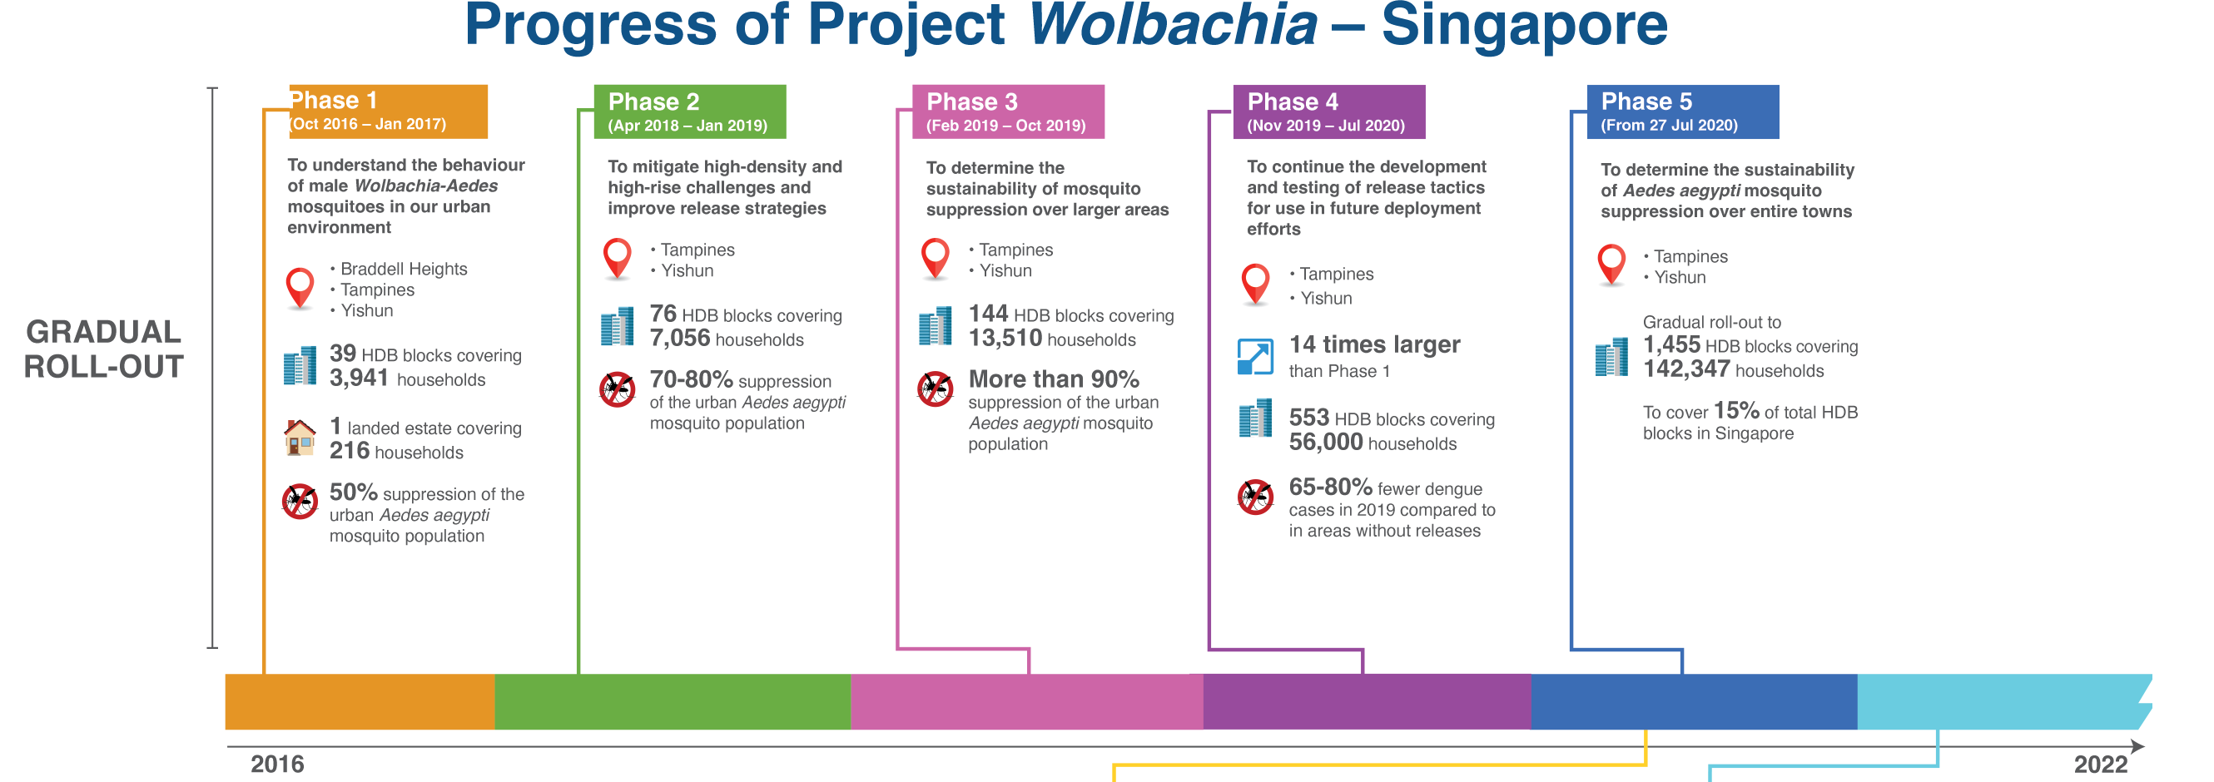
CLUSTER TREND (2015-2020 )
Project Wolbachia - suppresses urban Aedes aegypti mosquito populations, as eggs produced by matings between released male Wolbachia-Aedes mosquitoes and urban female Aedes aegypti mosquitoes do not hatch. -NEA
Notes:
https://www.nea.gov.sg/images/default-source/resources/project-wolbachia/mr-timeline-project-wolbachia_jun-2022v2.png

Slide 12
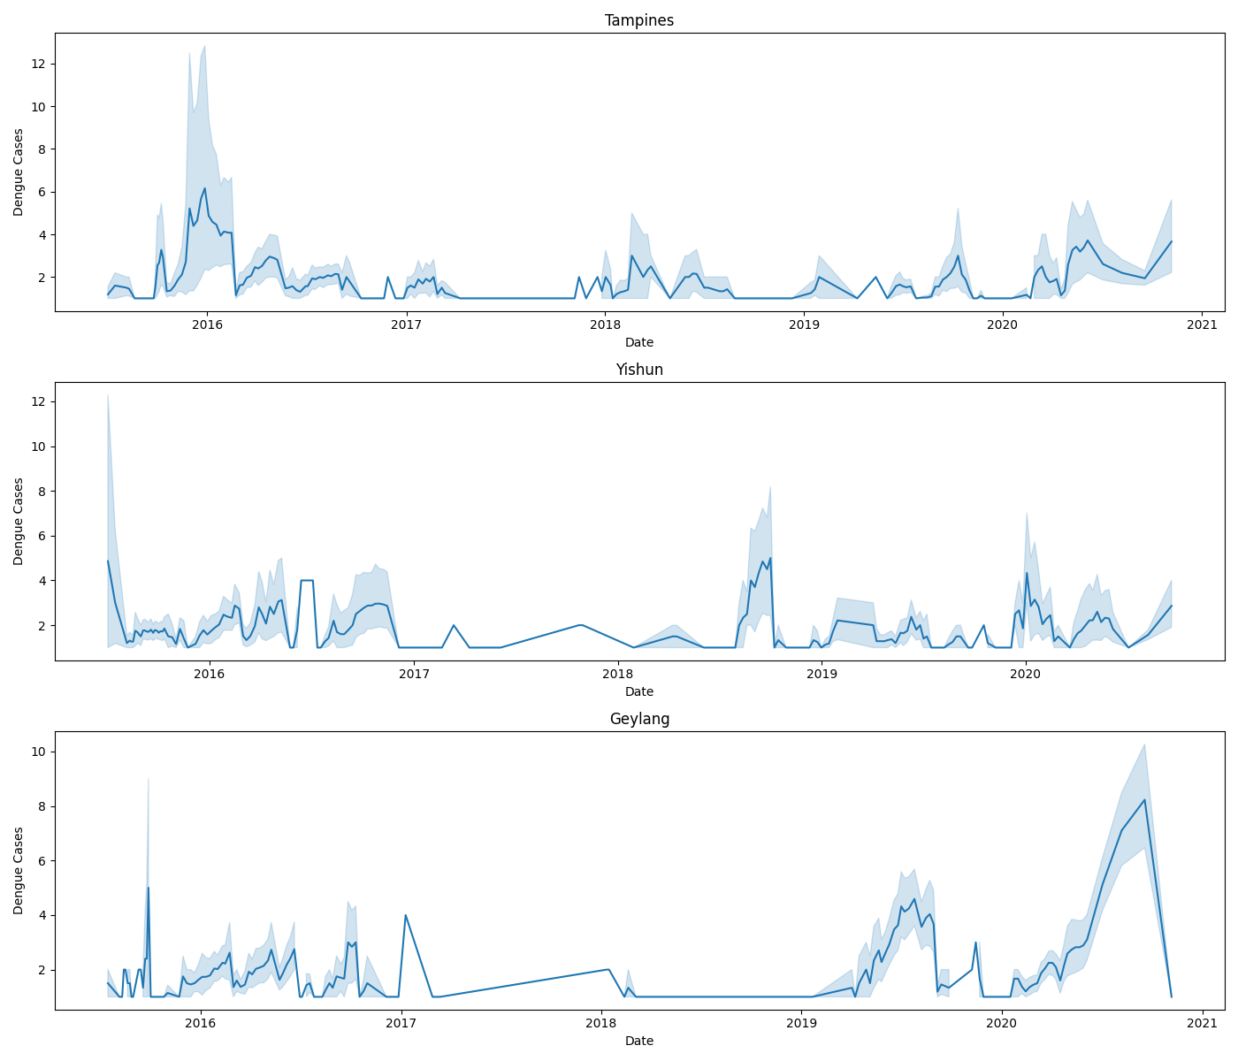
CLUSTER TREND (2015-2020 )
Est.:
Project Wolbachia Begins
No significant increase in dengue cases at targeted estates.
Future work to integrate estate rain data.
Targeted estates

Slide 13
Recommendations
Resource allocation
Use rainfall forecast to optimise prevention strategy and medical resources
Data-sharing
Accelerate Project Wolbachia

Slide 14
Thank You
Please keep this slide for the attribution

